Slide 1




Slide 2


Slide 3

Recursive Binary Splitting

Slide 4
Day | Weather | Temperature | Humidity | Wind | Play?
1 | Sunny | Hot | High | Weak | No
2 | Cloudy | Hot | High | Weak | Yes
3 | Sunny | Mild | Normal | Strong | Yes
4 | Cloudy | Mild | High | Strong | Yes
5 | Rainy | Mild | High | Strong | No
6 | Rainy | Cool | Normal | Strong | No
7 | Rainy | Mild | High | Weak | Yes
8 | Sunny | Hot | High | Strong | No
9 | Cloudy | Hot | Normal | Weak | Yes
10 | Rainy | Mild | High | Strong | No

Slide 5
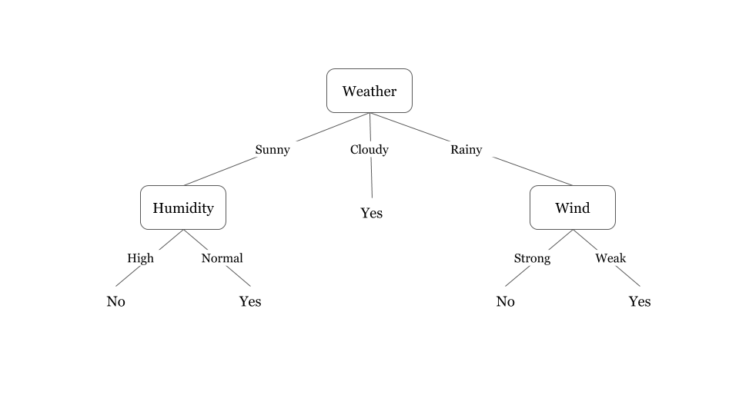

Slide 6


Slide 7


Slide 8




Entropy

Slide 9
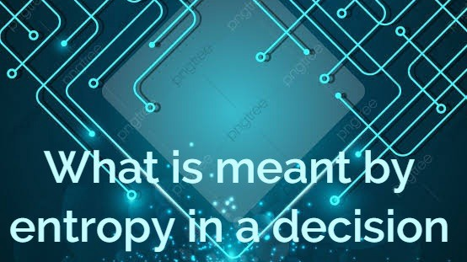

Slide 10
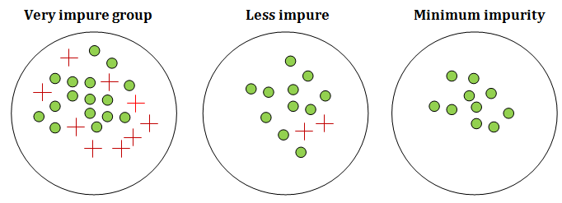
Impurity in data is called Entropy

Slide 11
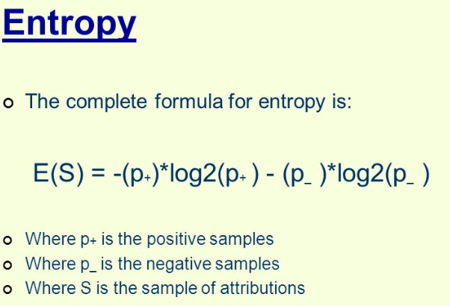
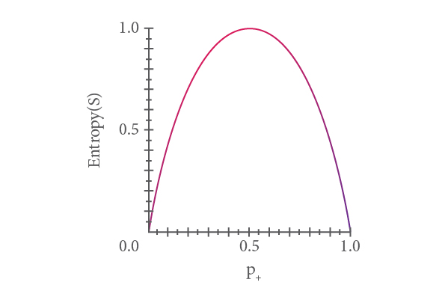

Slide 12
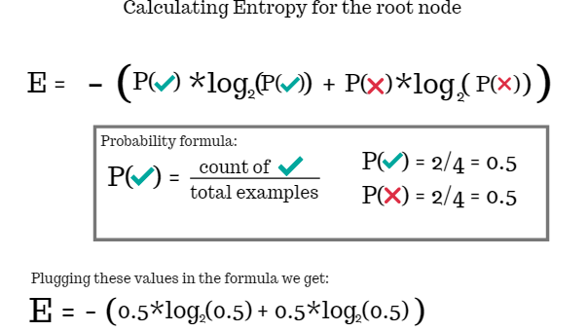

Slide 13
Day | Weather | Temperature | Humidity | Wind | Play?
1 | Sunny | Hot | High | Weak | No
2 | Cloudy | Hot | High | Weak | Yes
3 | Sunny | Mild | Normal | Strong | Yes
4 | Cloudy | Mild | High | Strong | Yes
5 | Rainy | Mild | High | Strong | No
6 | Rainy | Cool | Normal | Strong | No
7 | Rainy | Mild | High | Weak | Yes
8 | Sunny | Hot | High | Strong | No
9 | Cloudy | Hot | Normal | Weak | Yes
10 | Rainy | Mild | High | Strong | No

Slide 14
Entropy Attribute
Weather:
 | Yes | No
Sunny | 1 | 2
Cloudy | 3 | 0
Rainy | 1 | 3
I(Sunny) = [1/3* log(1/3) + 2/3 * log(2/3)] = 0.5 X 3/10 = 0.10
I(Cloudy) = [3/3* log(3/3) + 0/3 * log(0/3)] = 0.5 X 3/10 = 0.20
I(Rainy) = [1/4* log(1/4) + 3/4 * log(3/4)] = 0.5 X 3/10 = 0.10
---------------------------------------------------------------------------------------------
Entropy = E(Weather) = 0.40

Slide 15
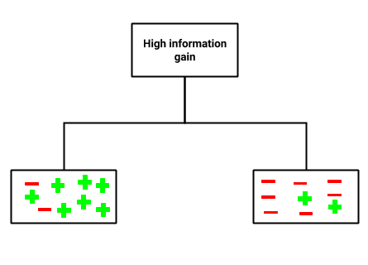
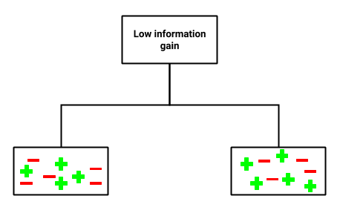
Calculating information gain

Slide 16
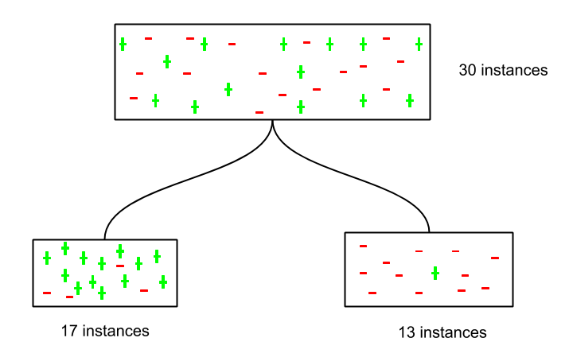
Example of decision tree sorting instances based on information gain

Slide 17
information gain of Target Attribute
Target Attribute = Play
Play = Yes = 5
Play = No = 5
#Hence IG of target is = 1

Slide 18
Similarly, we can calculate the information gain for each attribute (from the set of attributes) and select the attribute with highest information gain as the best attribute to split upon

Slide 19


Gain = IG – E(A)
Gain (Weather) = 1 – 0.4 = 0.6
Gain (Humidity) = 1 – 0.7 = 0.3
Gain (Wind) = 1 – 0.7 = 0.3
Gain (Temperature) = 1 – 0.85 = 0.15

Slide 20
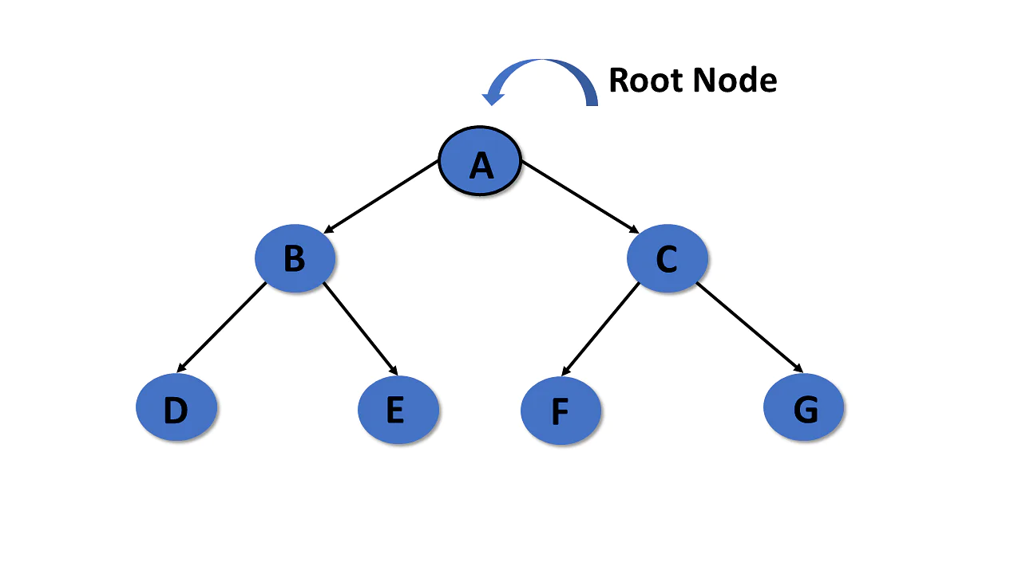
(Weather) attribute or columns Root Node
Its having highest Gain value = 0.6

Slide 21
Now We can decide

Slide 22
Let’s Code
Jupyter Notebook

Slide 23
Decision tree Example Data
No | Company | Degree | Experience | Salary (Rs.)
1 | Meta | Master | 2 | 10000
2 | Google | Bachelor | 5 | 12000
3 | Google | Master | 6 | 20000
4 | Amazon | Bachelor | 4 | 15000
5 | Amazon | Bachelor | 2 | 11000
6 | Meta | Bachelor | 3 | 9000
7 | Microsoft | Bachelor | 2 | 12000
8 | Microsoft | Master | 5 | 18000

